Slide 1
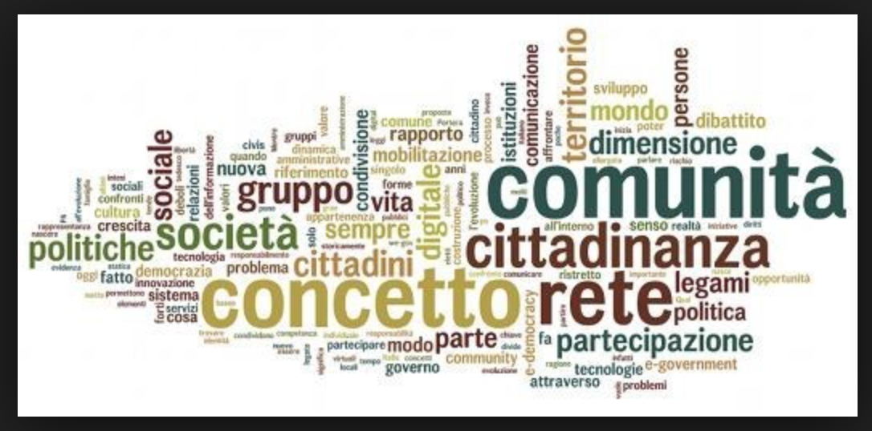
MODULE 5 ”ACTIVE CITIZENSHIP”
We have built the present module on “Active Citizenship” on the basis of the following theories:

Slide 2
Education and Training 2020 (ET 2020)
As everyone knows, the European Community does not have the competence to legislate on education and training within the Countries of the Union.
However, for years it has produced Guidelines on these matters that were then accepted and implemented by Member States. The last ones are Education and Training 2020 (ET 2020).

Slide 3
Strategic objective 3: Promoting equity, social cohesion and active citizenship/ (Audio: Within ET 2020, the European Community has set four strategic objectives concerning education. What we are interested in this context is Objective 3 which aims to promote equity, social cohesion, and active citizenship.)
Irrespective of personal, social or economic situation, Education and training policy should enable every citizen to acquire, update and develop over a lifetime both job-specific skills and the key expertise. These are necessary to their employability and to promote further learning, active citizenship, and intercultural dialogue. Education and training systems should aim to ensure that every student completes the education path, including those coming from disadvantaged backgrounds, with special needs and the migrants. Where appropriate, there is planned the possibility of a second-chance education and a personalized learning plan. Education should promote intercultural competences, democratic values, and respect for fundamental rights.

Slide 4
Promoting equity, social cohesion and active citizenship
Promoting Equity, Social Cohesion and Active Citizenship
The European Union has developed a range of support actions, including Erasmus+, to achieve the ET2020 objectives.
The main task of these projects focuses the educational actions on achieving these goals. In this specific case, the goal is Active Citizenship.

Slide 5
Citizenship
Citizenship is the condition of the natural person (said citizen) to whom the law of a State recognizes the fullness of civil, political and social rights.
The State may acknowledge these rights at least in part also to non-citizens, on the basis of multilateral international agreements (stemming from membership of the UN or the European Union, for example), or bilateral agreements (following treaties providing for reciprocal and favourable treatments of the citizens of one State by the other), or even after a unilateral choice (for example, in the context of integration policies for migrants living on the national territory). These factors have led to the granting of civil rights to non-citizens in current states. This recognition is usually enshrined in the Constitution, while social rights and especially political rights still tend to be linked to citizenship.
However, do student have some information about their rights, whether they are citizens of the country where they live or not?

Slide 6
Once, in Italy, it was foreseen that students were informed about their rights connected with nationality condition or residency in the context of the subject called Civic Education. The teaching had been focused on the study of the Italian Constitution. Today, the new legislation settles transversal teachings called Education for Citizenship: therefore, besides the Italian Constitution, this subject teaches the European Institutions and the applicable treaties. The result is still weak. Students show little interest in such topics and are less and less informed about their rights.
And in classroom…
In Italy we talk about 'citizenship' in the lessons of
CIVIC EDUCATION
Italian Constitution
European Institutions
ACTIVE CITIZENSHIP

Slide 7
Active Citizenship
Active citizenship, or civic activism in general, means the set of self-organization forms that involve the exercise of powers and responsibilities in public policy, in order to enforce rights, protect the common public asset, and support vulnerable persons.
consumer associations
environmental groups
cooperatives and social enterprises
voluntary organizations
international cooperation organizations
citizens' advice and support centres
women's or migrants' rights movements
On average, Italian students can not describe themselves as fully active citizens. However, what does active citizenship mean? When we talk about active citizenship, in Italy we do not think about individuals, but organizations that, in various ways, carry the burden of protecting the rights of citizens, as prescribed by the Constitution. We could say that active citizenship is exercised by proxy.

Slide 8
DEMOCRACY
SEVERAL ANCIENT DEFINITIONS OF DEMOCRACY
Since the nineteenth century, democracy has been increasingly identified with particular political rights:
the right to vote
the right to be a candidate
the right of free political association

Slide 9
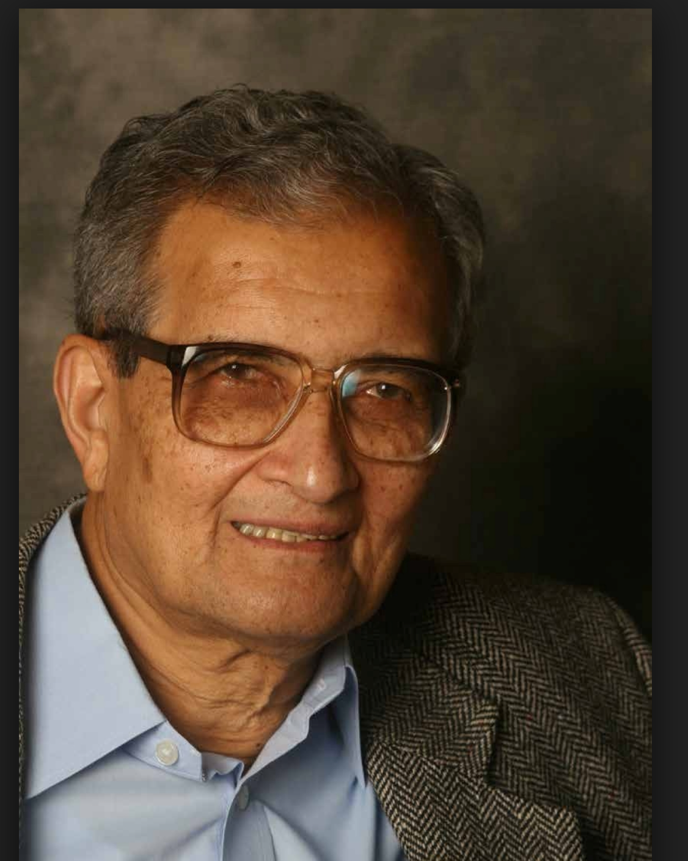
Democracy as a debate
Over the past 150 years, we have increasingly lost a principle: the three political rights mentioned above do not in themselves generate democracy unless an essential component supports them, the debate. Amartya Sen reminds us of that. What is the democracy, really? The great Indian academic answers: The government through the debate.
Amartya Kumar Sen
(Indian economist, 1933)
Contributions: Human Development Theory
Nobel Memorial Prize in Economic Science (1998)

Slide 10
Democracy and active citizenship
Educating young people in the democracy means training them in the debate
The reflections conducted so far have led to defining an educational action on Active citizenship that has the following objective:
educating young people in the democracy means training them in the debate.

